Slide 1
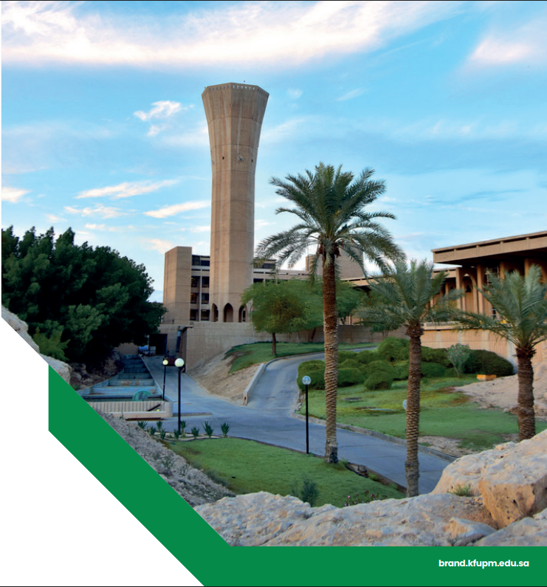

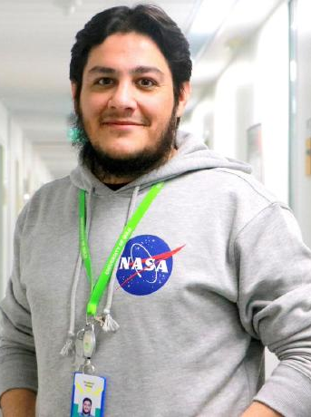

Moonlight: Enhanced Deep Learning for Breast Cancer Detection
An advanced framework designed to improve accuracy, robustness, and interpretability of breast cancer diagnosis from histopathological images.
Dr. Muzammil Behzad
Assistant Professor
Information & Computer Science Department,
King Fahd University of Petroleum and Minerals, Saudi Arabia.
Eng. Hassan Al-Dahneen
MX Student – Artificial Intelligence
Information & Computer Science Department,
King Fahd University of Petroleum and Minerals, Saudi Arabia.

Slide 2

AGENDA
1
Project Resources
30 Sec
2
Intro - Breast Cancer
30 Sec
3
Current DL Models For Breast Cancer & Their Limitations
1 Min
4
Proposed Enhancements
4 Min
5
Results & Observations
2 Min
6
Future Work
1 Min
7
What I Learned
1 Min

Slide 3
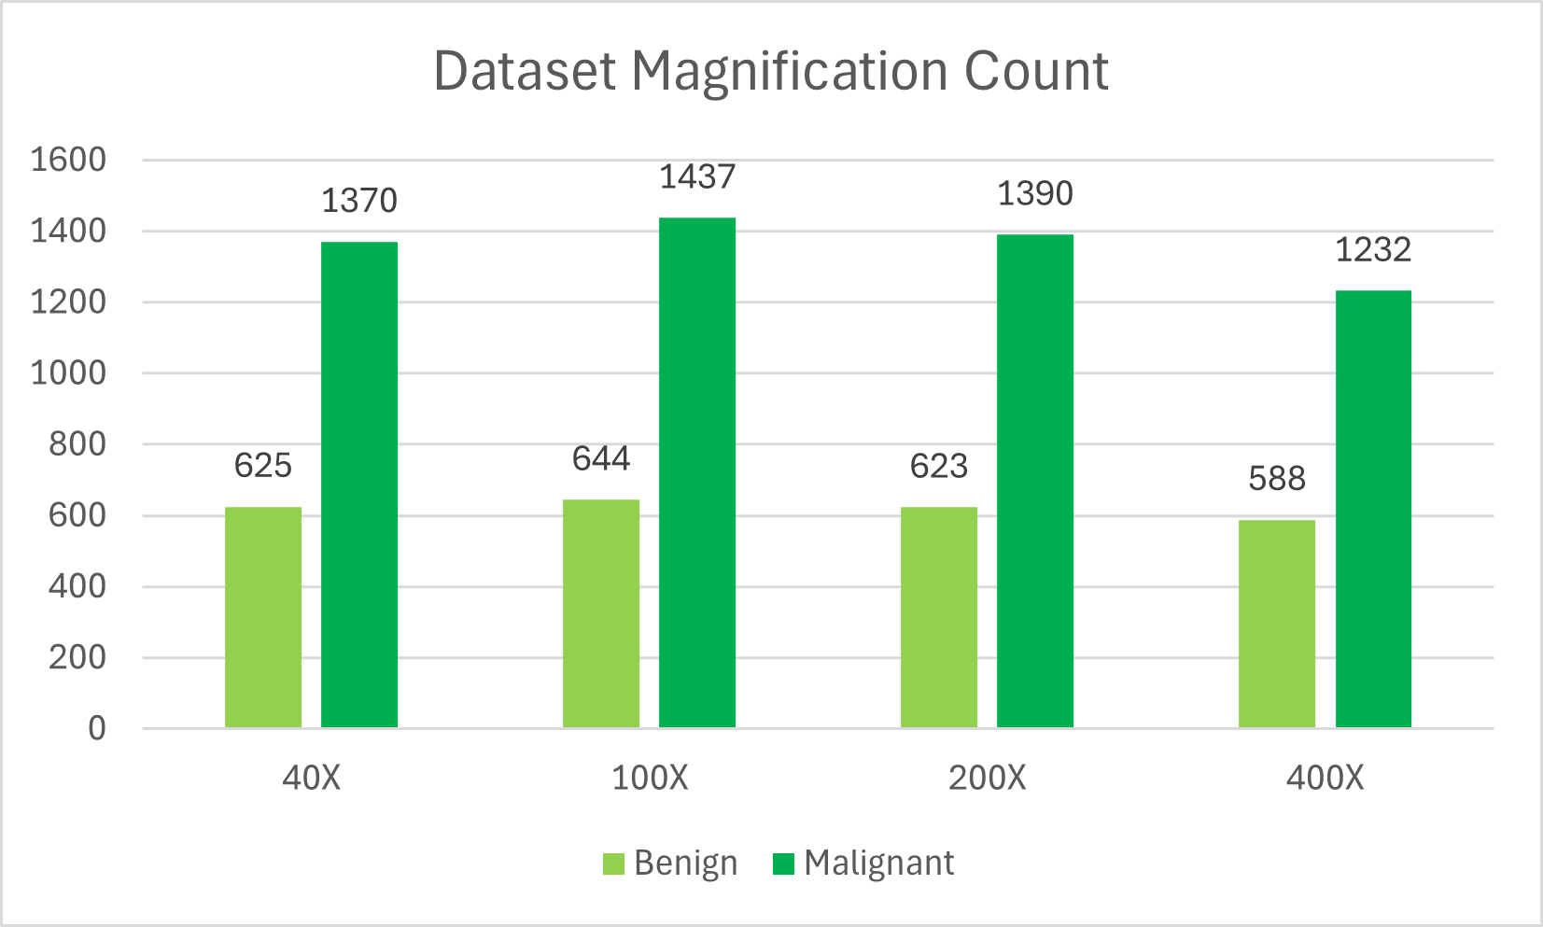
Project Resources
BreaKHis Dataset
Project Report
Reference Paper
Reference GitHub Repository
Trained Models
BreaKHis dataset contains 7,909 histopathological images of breast tumor tissue. Each image is categorized as either benign (2,486images) or malignant (5,423 images)

Slide 4

Intro - Breast Cancer
Breast cancer remains one of the most prevalent and life-threatening diseases among women worldwide. Early and accurate diagnosis is critical for improving survival rates and treatment outcomes.
1
Histopathological Analysis
The gold standard for diagnosing breast cancer, but often time-consuming and dependent on expert pathologists.
2
Manual Examination
Can introduce variability and errors due to fatigue or subjective interpretation.

Slide 5
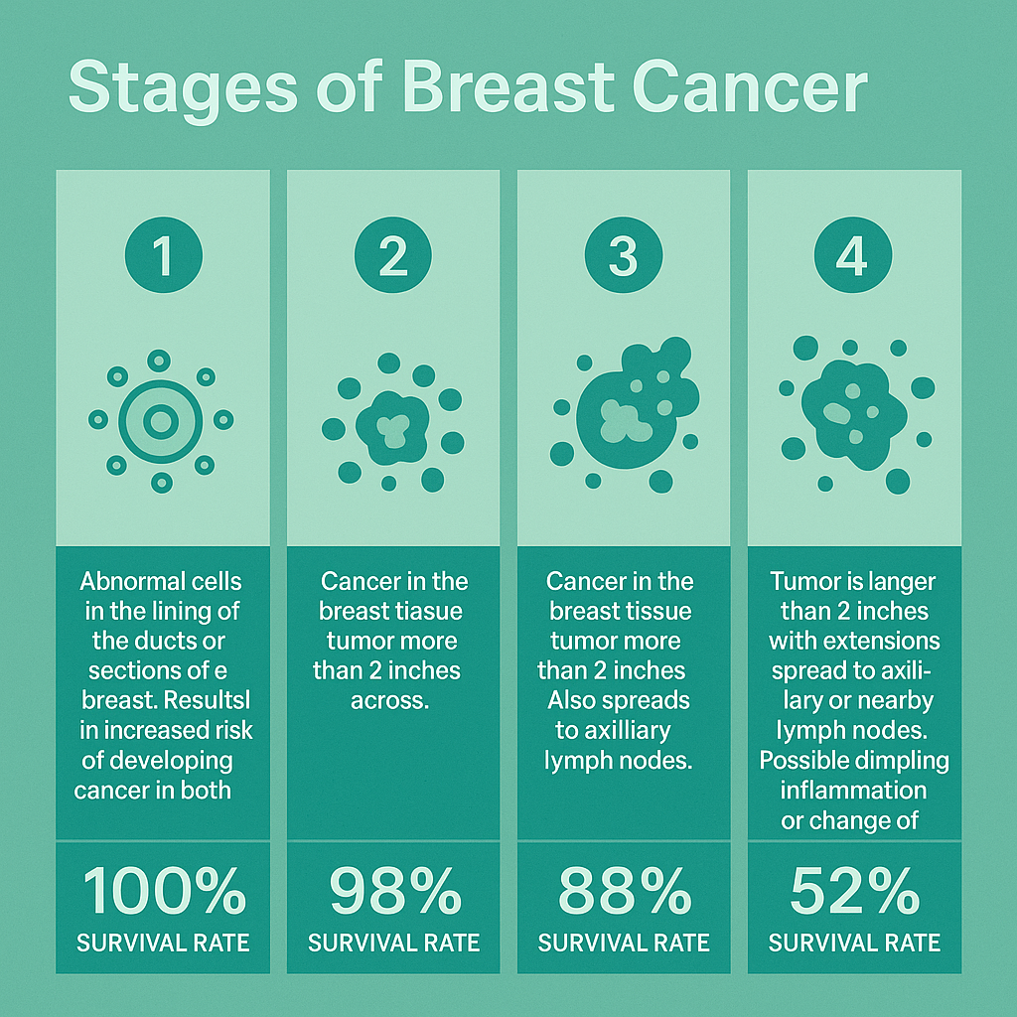




Intro - Breast Cancer “Continue”
Breast Pain
Nipple Discharge
Redness Or Swelling In One Breast
Change In The Apparency Of The Nipple

Slide 6
Current DL Models For Breast Cancer & Their Limitations
Domain Misalignment
Insufficient Loss Optimization
Insufficient Data Augmentation
Lack of Interpretability
Color Information Loss
Notes:
Domain Misalignment: Pretrained DL model is not optimized for histopathological features of different Cancer types.
Insufficient Loss Optimization: Conventional loss functions like cross-entropy do not always reflect the structural or perceptual similarity required in fine-grained medical image classification, leading to suboptimal feature learning and misclassification of borderline cases.
Insufficient Data Augmentation: Basic augmentations don't simulate real-world slide variability.
Lack of Interpretability: Black-box predictions limit clinical adoption.
Color Information Loss: Grayscale inputs discard vital diagnostic color cues.

Slide 7
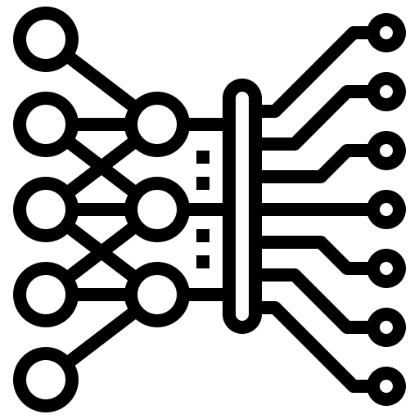
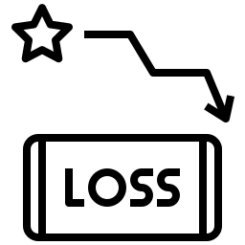


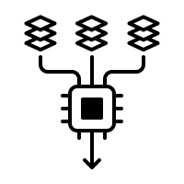


Proposed Enhancements
Model
Loss
Augmentation
Training
Testing
Interpretability
Config
Added residual, efficient, and U-Net classifiers with plug-and-play architecture loader
Introduced Focal, and Composite loss with modular config
Advanced augmentation option to simulate clinical variability
Configurable via CLI, supports AMP, early stopping, learning rate scheduling
Extended to compute and display full performance metrics
Grad-CAM++ and Grad-CAM implemented for XAI support
Reproducible experiment design using structured JSON + CLI control

Slide 8
Used Layers / Block And Their Benefits
Layer / Block | Description | Benefit | Primary Layers | Optional Layers
Encoder Block | Extracts local spatial features and reduces spatial resolution through convolution and pooling. | Feature Learning | Conv2D → ReLU → MaxPool | BatchNorm, Dropout
Residual Block | Learns deeper feature representations while preserving identity mappings to stabilize training. | Feature Learning & Optimization | Conv2D → BatchNorm → ReLU + Element-wise Add | Shortcut Conv2D + Shortcut BN
Depthwise Separable Conv Block | Efficiently extracts spatial and channel-wise features with reduced computation and parameters. | Lightweight Feature Learning | Depthwise Conv2D → Pointwise Conv2D | BatchNorm, ReLU
Adaptive Average Pooling Layer | Compresses spatial dimensions to a fixed size, preparing feature maps for the classifier. | Spatial Compression | AdaptiveAvgPool2D | None
Flatten Layer | Reshapes multi-dimensional feature maps into a 1D vector suitable for Fully Connected layers. | Data Reshaping | Flatten | None
Fully Connected Layer / Block | Learns combinations of extracted features to make final classification decisions. | Feature Interpretation & Classification | Linear Layer (FC) | ReLU, Dropout
Output Layer (Softmax) | Converts final logits into probability distributions over output classes. | Final Classification | Softmax | None

Slide 9
Proposed Enhancements – New Models Architecture
SimpleCNN
16 Layers: 3×(Conv + ReLU + MaxPool) + AdaptiveAvgPool + Flatten + 2×FC + ReLU+ Dropout + Output Layer (Softmax)
ResidualModel
24 Layers: Conv + BN + ReLU + MaxPool + 2×ResidualBlock(3×Conv + 3×BN + 2×ReLU) + AdaptiveAvgPool + Flatten + FC + Output Layer (Softmax)
EfficientConvModel
16 Layers: 3×(Depthwise + Pointwise + BN + ReLU) + AdaptiveAvgPool + Flatten + FC + Output Layer (Softmax)
UNetClassifier
29 Layers: 4×(Conv + BN + ReLU + MaxPool) + ResidualBlock(2×Conv + 2×BN + 2×ReLU) + AdaptiveAvgPool + Flatten + 2×FC + ReLU + Dropout + Output Layer (Softmax)
Input (Image size: 224 × 224 × 3)
Input (Image size: 224 × 224 × 3)
Input (Image size: 224 × 224 × 3)
Input (Image size: 224 × 224 × 3)
Encoder Block 1
Conv2D (3→32) → ReLU → MaxPooling
Encoder Block
Conv2D (3→32) → BatchNorm → ReLU → MaxPool (2×2)
Encoder Block 1
Conv2D (3→32) → BatchNorm → ReLU → MaxPool (2×2)
Depthwise Separable Conv Block 1
├ Depthwise Conv (3→3) → Pointwise Conv (3→32)
└─ BatchNorm → ReLU
Encoder Block 2
Conv2D (32→64) → BatchNorm → ReLU → MaxPool (2×2)
Encoder Block 2
Conv2D (32→64) → ReLU → MaxPooling
Residual Block 1
├ Conv2D (32→64, stride=1) → BatchNorm → ReLU
├ Conv2D (64→64, stride=1) → BatchNorm
└ Shortcut: Conv2D (32→64, stride=1) → BatchNorm
→ Element-wise Add (Main + Shortcut) → ReLU
Depthwise Separable Conv Block 2
├ Depthwise Conv (32→32) → Pointwise Conv (32→64)
└─ BatchNorm → ReLU
Encoder Block 3
Conv2D (64→128) → BatchNorm → ReLU → MaxPool (2×2)
Encoder Block 3
Conv2D (64→128) → ReLU → MaxPooling
Encoder Block 4
Conv2D (128→256) → BatchNorm → ReLU → MaxPool (2×2)
Residual Block 2
├ Conv2D (64→128, stride=2) → BatchNorm → ReLU
├ Conv2D (128→128, stride=1) → BatchNorm
└ Shortcut: Conv2D (64→128, stride=2) → BatchNorm
→ Element-wise Add (Main + Shortcut) → ReLU
Depthwise Separable Conv Block 3
├ Depthwise Conv (64→64) → Pointwise Conv (64→128)
└─ BatchNorm → ReLU
Adaptive Average Pooling (1×1)
Residual Block
├ Conv2D (256→256) → BatchNorm → ReLU
└─ Conv2D (256→256) → BatchNorm
→ Element-wise Add (Residual Connection) → ReLU
Flatten
Adaptive Average Pooling (1×1)
Adaptive Average Pooling (1×1)
Adaptive Average Pooling (1×1)
Fully Connected Block
(Linear: 128 → 128) → ReLU → Dropout(0.5)
Flatten
Flatten
Flatten
Fully Connected Block
(Linear: 256 → 128) → ReLU → Dropout(0.5)
Fully Connected (Linear: 128 → 2)
Fully Connected (Linear: 128 → 2)
Fully Connected (Linear: 128 → 2)
Fully Connected (Linear: 128 → 2)
Output Layer (Softmax for 2 classes: Benign / Malignant)
Output Layer (Softmax for 2 classes: Benign / Malignant)
Output Layer (Softmax for 2 classes: Benign / Malignant)
Output Layer (Softmax for 2 classes: Benign / Malignant)
Note that DenseNet121 uses the torchvision.models.densenet121 and it has ~122 layers “As per paper: 121 layers (conv/bn/relu) + final Linear classifier”.

Slide 10
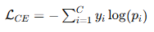
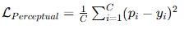
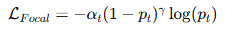
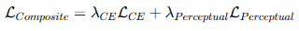
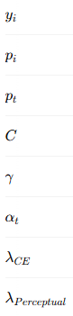
Proposed Enhancements – Loss
CrossEntropy Loss
Standard loss that penalizes incorrect class prediction by comparing logits to true label.
Perceptual Loss
Measures similarity between predicted softmax distribution and true labels using MSE.
Focal Loss
A dynamically scaled version of CrossEntropy Loss that focuses learning on harder examples.
Composite Loss
A hybrid combining CrossEntropy Loss and Perceptual Loss to balance classification and distribution alignment.
True label (one-hot encoding)
Focusing parameter For Focal Loss (2)
Predicted softmax probability for class i
Balancing factor in Focal Loss
Probability for the true class
Weight for Cross Entropy in Composite Loss (1)
Number of classes
Weight for Perceptual Loss in Composite Loss (0.5)
CrossEntropy is the standard PyTorch (nn.CrossEntropyLoss). While other 3 loss functions were manually implemented.

Slide 11
Proposed Enhancements - Augmentation
1
Basic Augmentation:
Resize(224×224)
Normalize(mean=0.5, std=0.5)*
Applied to all training images with no variability
2
1
2
Advanced Augmentation
Normalize(mean=0.5, std=0.5)*
RandomResizedCrop(224)
RandomHorizontalFlip(p=0.5)
RandomRotation(degrees=15)
ColorJitter: modifies brightness and contrast
* Normalization was changed after experiment 9 to be Normalize((0.5, 0.5, 0.5), (0.5, 0.5, 0.5)) so both will process full RGB image instead of grayscale only.

Slide 12
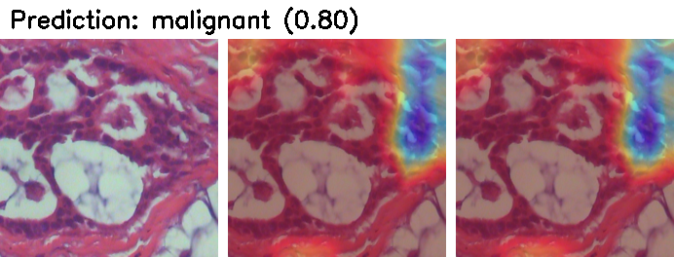
Proposed Enhancements – Training, Testing and Interpretability
Save Best
Input
Augment
Processing & Training
Validate & Monitor
Testing and Evaluation
Visual Explanation
DL Model
Notes:
Preprocessing: Include resizing, flipping, rotating, and color adjustments. These augmentations help the model generalize better by simulating real-world variations.
Once the images are processed, they are fed into a deep learning model. The model is trained to distinguish between benign and malignant tissue patterns.
During training, the system monitors how well the model performs on validation samples and automatically saves the best version of the model for later testing.
After training, the saved model is tested on previously unseen images. The system generates a full performance report that includes accuracy, precision, recall, and F1-score.
To make the model’s decisions understandable, a visual explanation technique called Grad-CAM is used. It highlights the areas in the tissue image that the model focused on when making its prediction. This helps build trust and offers insights for clinical review.

Slide 13
Results & Observations
Experiments Setup
Exp # | Architecture | Loss Function | Augmentation | Input Type
Exp1 | DenseNet121 | CrossEntropy | Basic | Grayscale
Exp2 | ResidualModel | CrossEntropy | Advanced | Grayscale
Exp3 | EfficientConvModel | CrossEntropy | Basic | Grayscale
Exp4 | SimpleCNN | CrossEntropy | Basic | Grayscale
Exp5 | ResidualModel | Perceptual | Advanced | Grayscale
Exp6 | EfficientConvModel | CrossEntropy | Advanced | Grayscale
Exp7 | ResidualModel | Composite | Advanced | Grayscale
Exp8 | EfficientConvModel | Composite | Advanced | Grayscale
Exp9 | SimpleCNN | Composite | Basic | Grayscale
Exp10 | UNetClassifier | Composite | Basic | RGB
Exp11 | DenseNet121 | Focal | Basic | RGB
Exp12 | EfficientConvModel | CrossEntropy | Advanced | RGB
Exp13 | ResidualModel | Composite | Advanced | RGB
Exp14 | EfficientConvModel | Composite | Basic | RGB
Exp15 | UNetClassifier | Composite | Advanced | RGB
Exp # | Architecture | Loss Function | Augmentation | Input Type | Accuracy (%) | Precision (%) | Recall (%) | F1 Score (%)
Exp1 | DenseNet121 | CrossEntropy | Basic | Grayscale | 92.08 | 92.02 | 92.08 | 91.98
Exp2 | ResidualModel | CrossEntropy | Advanced | Grayscale | 88.95 | 88.82 | 88.95 | 88.85
Exp3 | EfficientConvModel | CrossEntropy | Basic | Grayscale | 91.75 | 91.69 | 91.75 | 91.65
Exp4 | SimpleCNN | CrossEntropy | Basic | Grayscale | 91 | 91.09 | 91 | 91.03
Exp5 | ResidualModel | Perceptual | Advanced | Grayscale | 87.46 | 87.29 | 87.46 | 87.19
Exp6 | EfficientConvModel | CrossEntropy | Advanced | Grayscale | 85.81 | 86.26 | 85.81 | 84.99
Exp7 | ResidualModel | Composite | Advanced | Grayscale | 88.87 | 88.77 | 88.87 | 88.81
Exp8 | EfficientConvModel | Composite | Advanced | Grayscale | 86.6 | 86.51 | 86.6 | 86.16
Exp9 | SimpleCNN | Composite | Basic | Grayscale | 92.58 | 92.71 | 92.58 | 92.41
Exp10 | UNetClassifier | Composite | Basic | RGB | 94.49 | 94.68 | 94.49 | 94.54
Exp11 | DenseNet121 | Focal | Basic | RGB | 93.12 | 93.24 | 93.12 | 93.16
Exp12 | EfficientConvModel | CrossEntropy | Advanced | RGB | 86.61 | 86.54 | 86.61 | 86.16
Exp13 | ResidualModel | Composite | Advanced | RGB | 86.81 | 86.94 | 86.81 | 86.87
Exp14 | EfficientConvModel | Composite | Basic | RGB | 91.61 | 91.56 | 91.61 | 91.5
Exp15 | UNetClassifier | Composite | Advanced | RGB | 89.48 | 89.51 | 89.48 | 89.49
Original Model
Top Performance Models

Slide 14
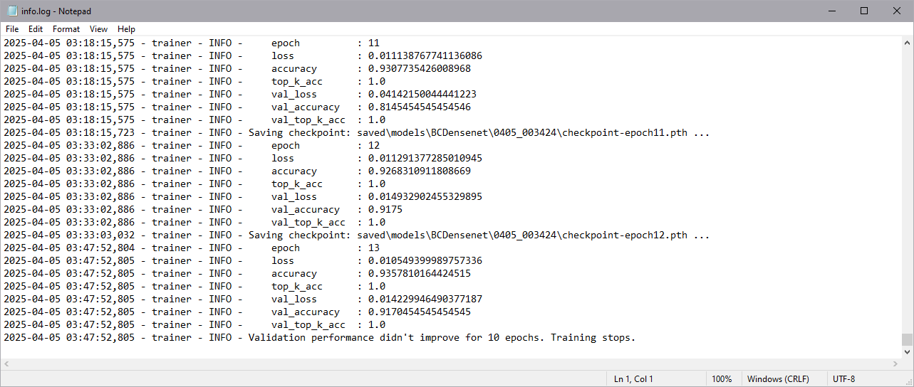
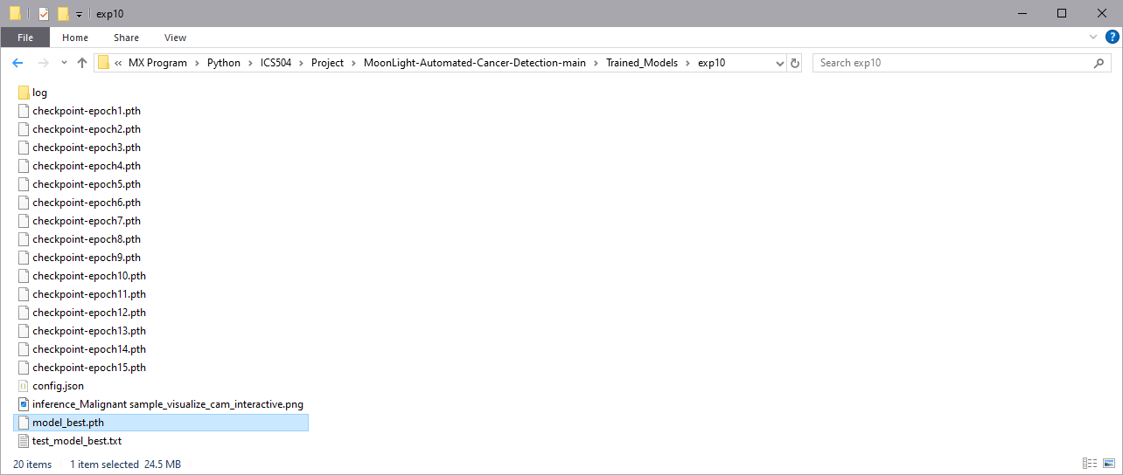
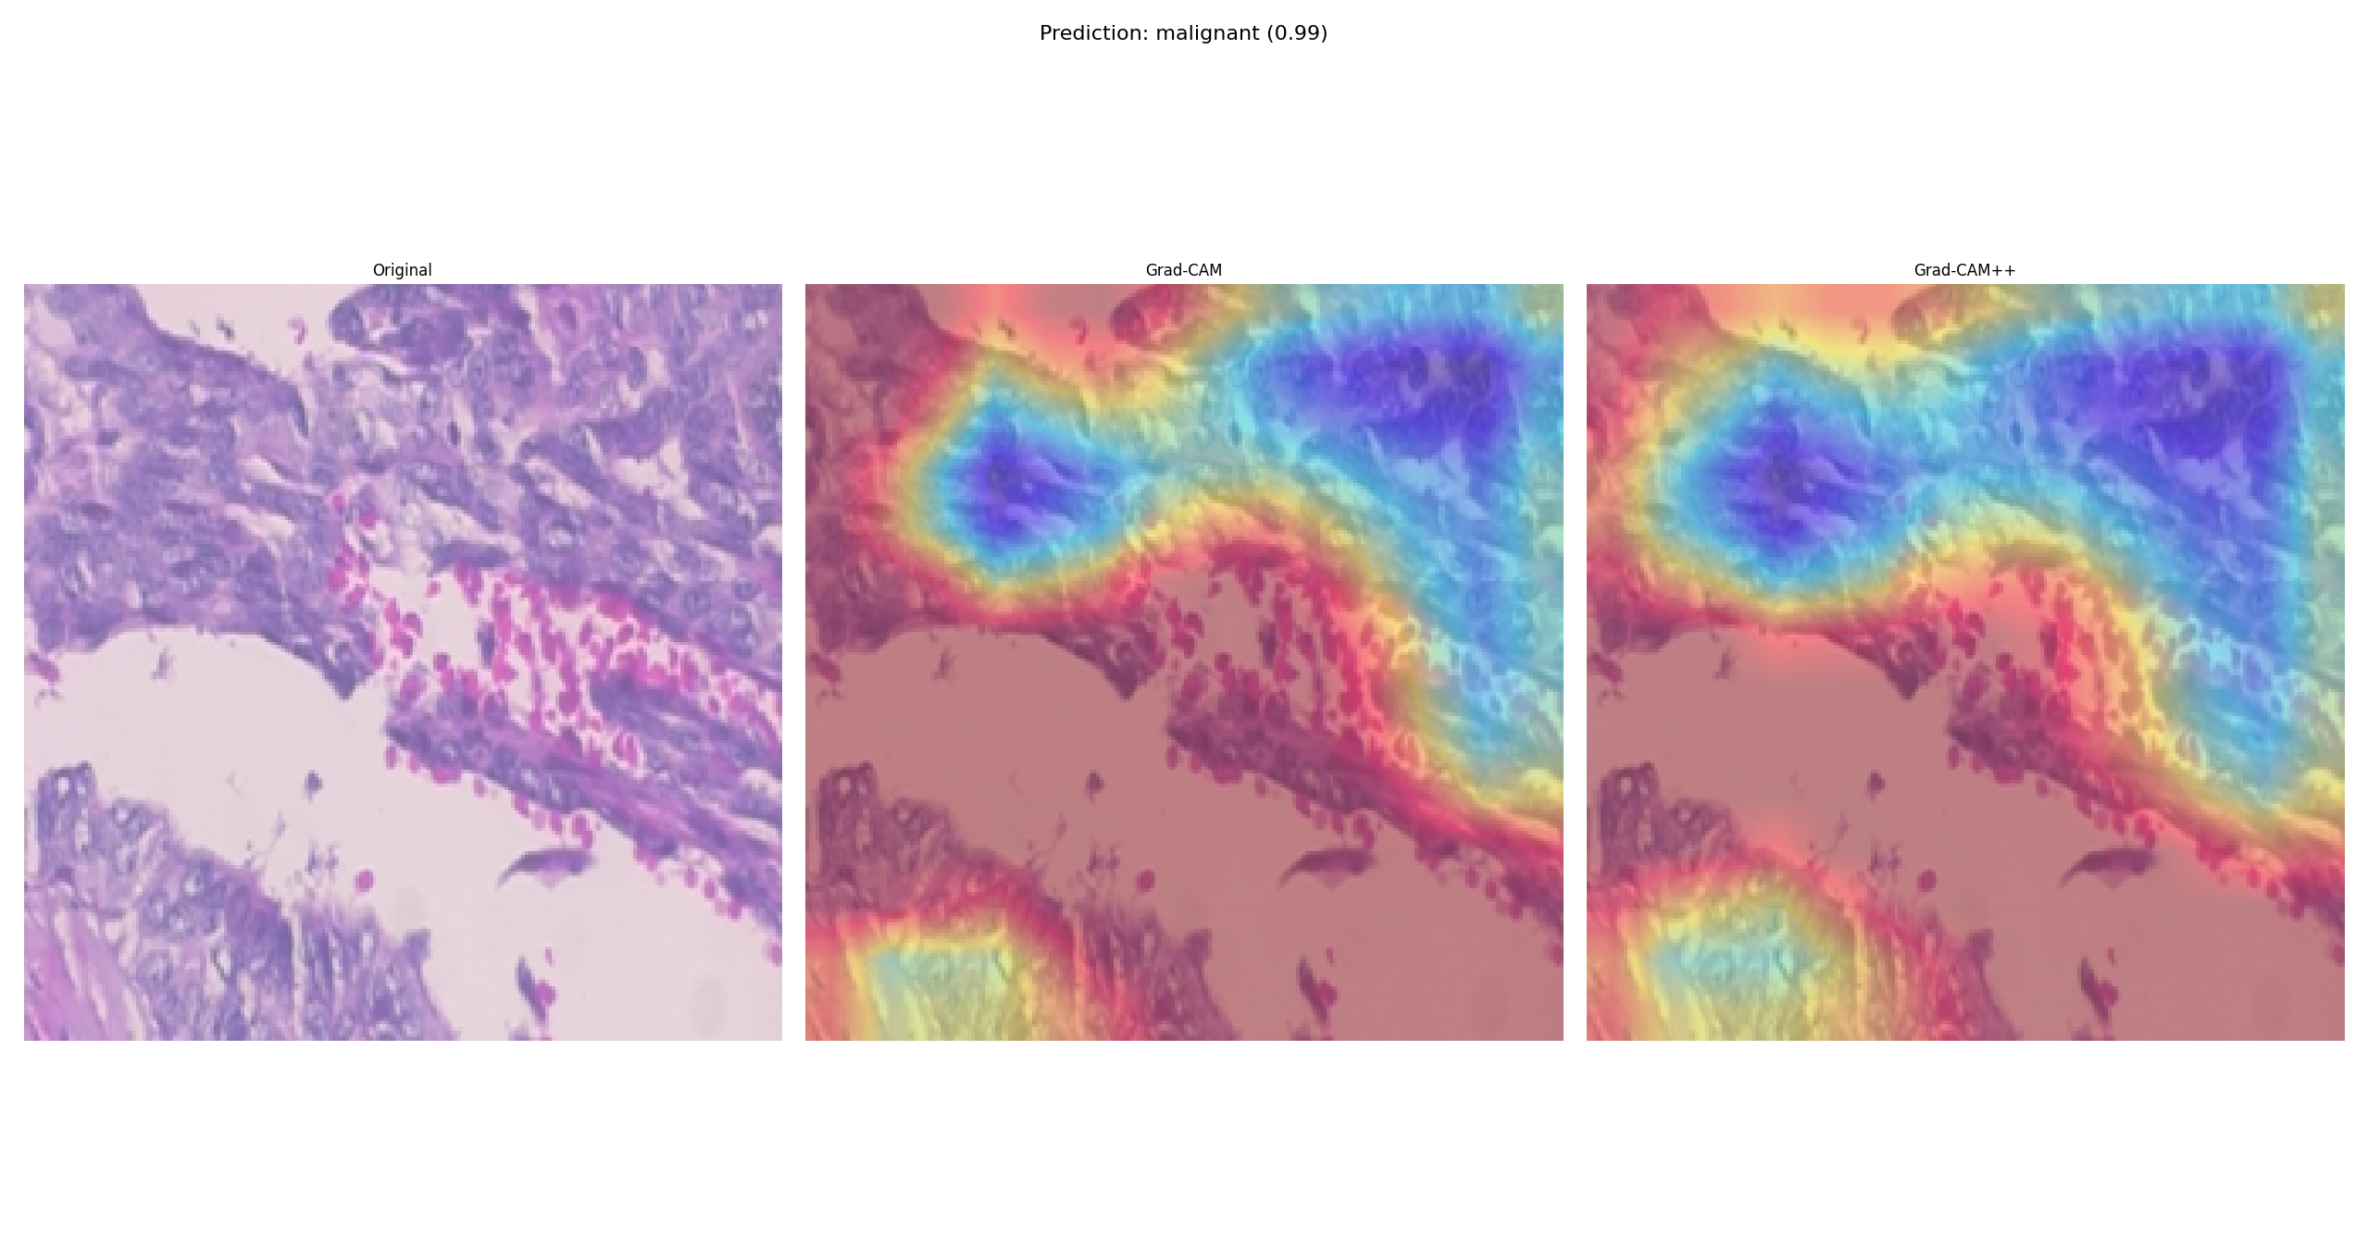
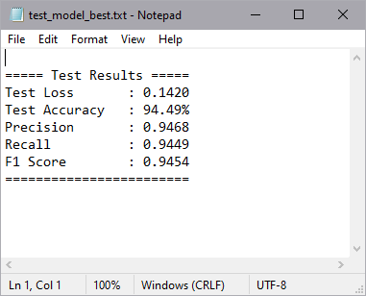
Results & Observations “Continue”
All Experiments fished the full 15 epochs cycles except Experiments#11 which stopped after epoch#13

Slide 15
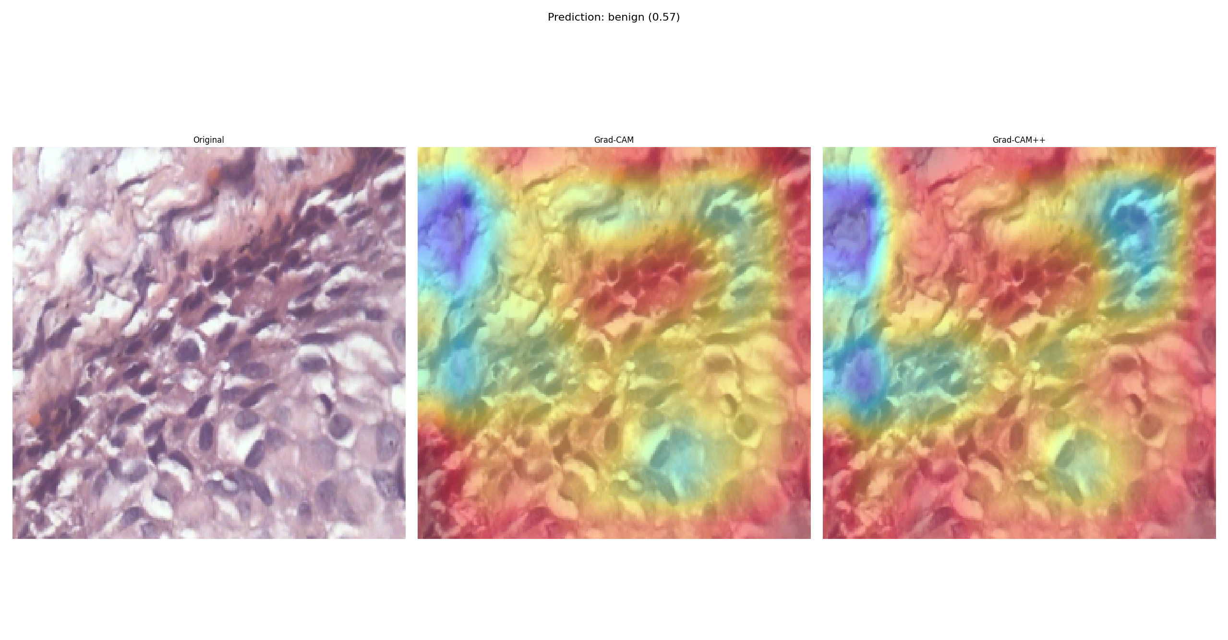
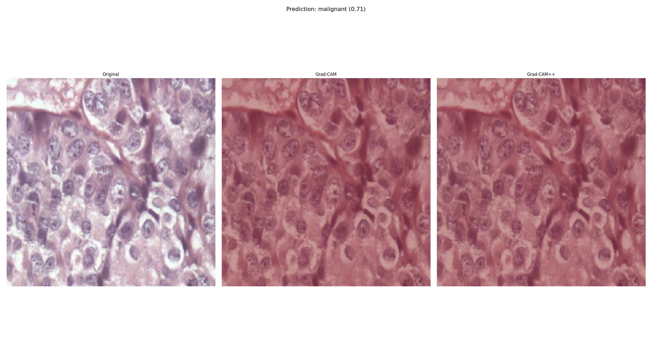
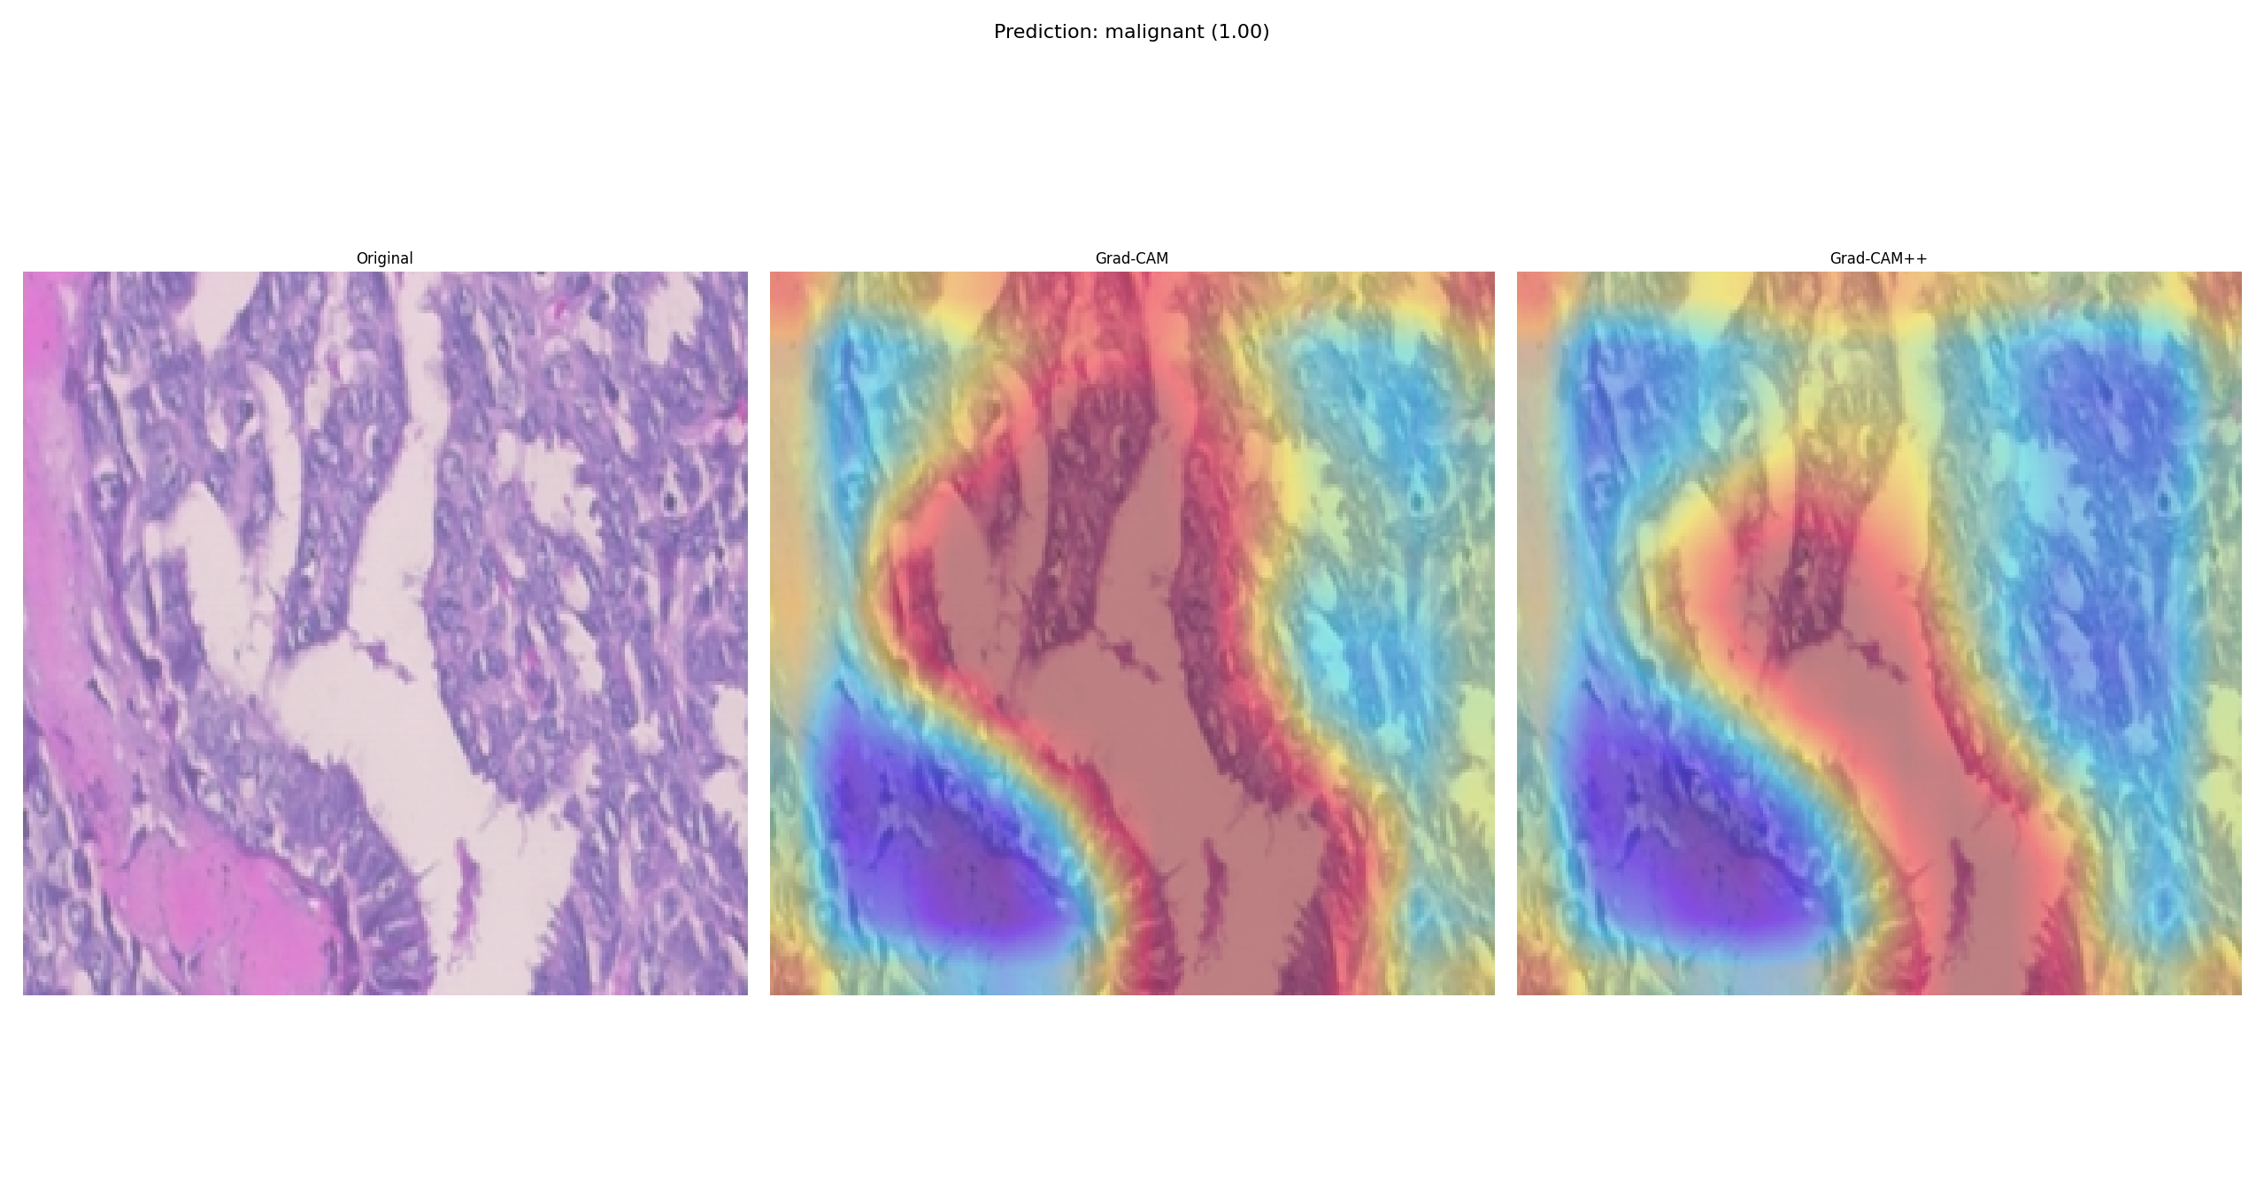
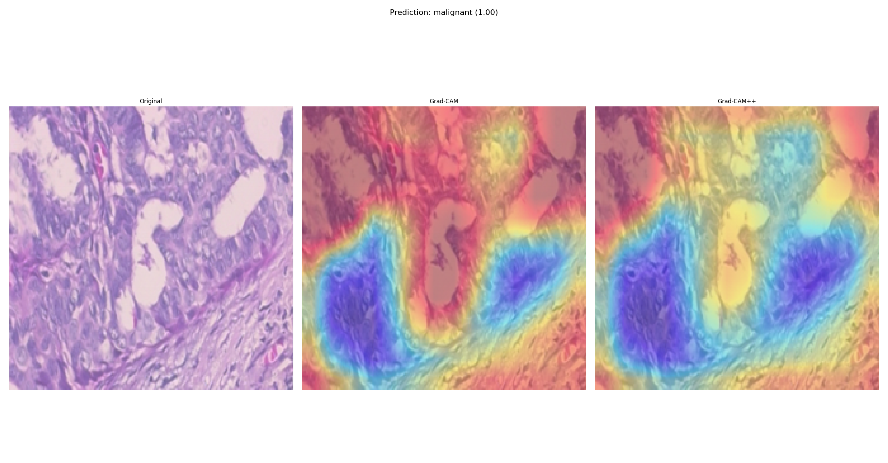
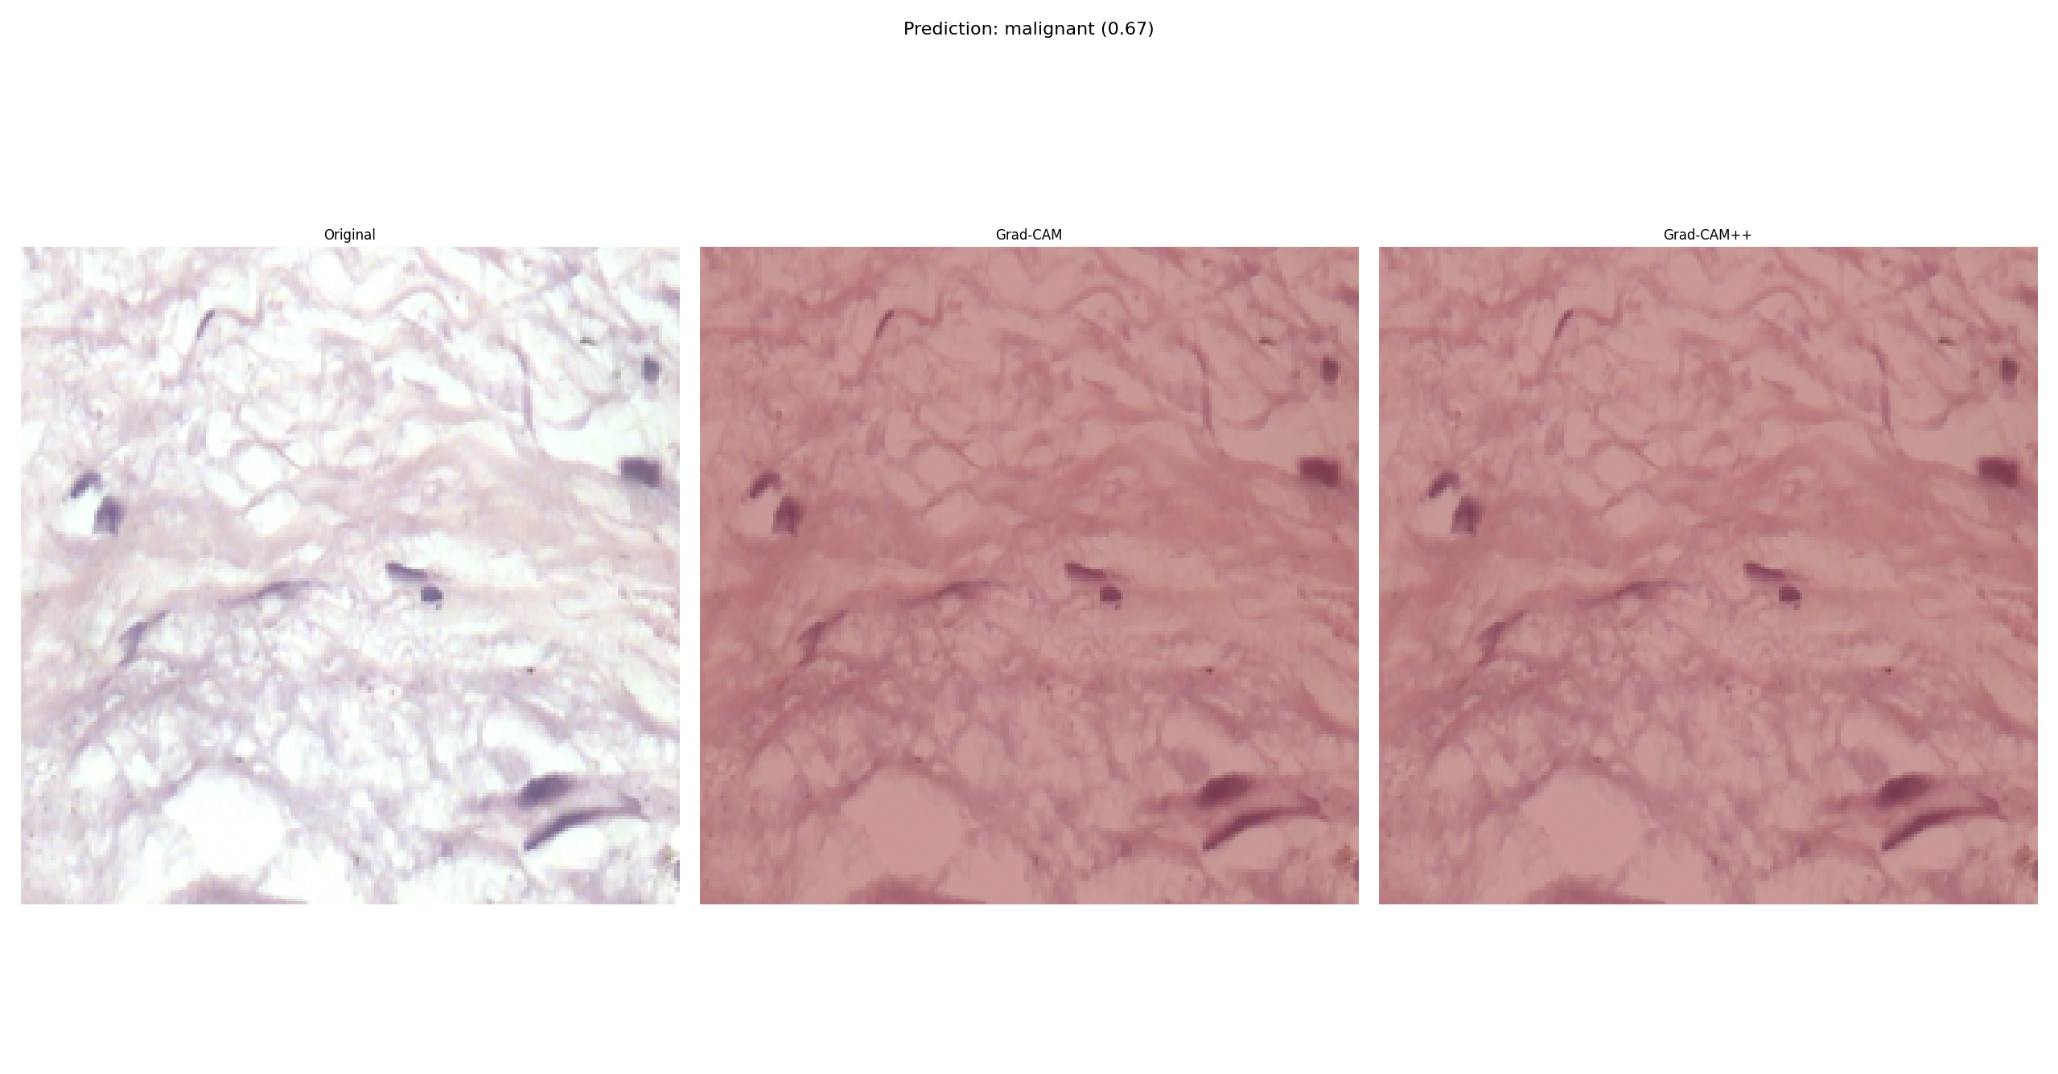
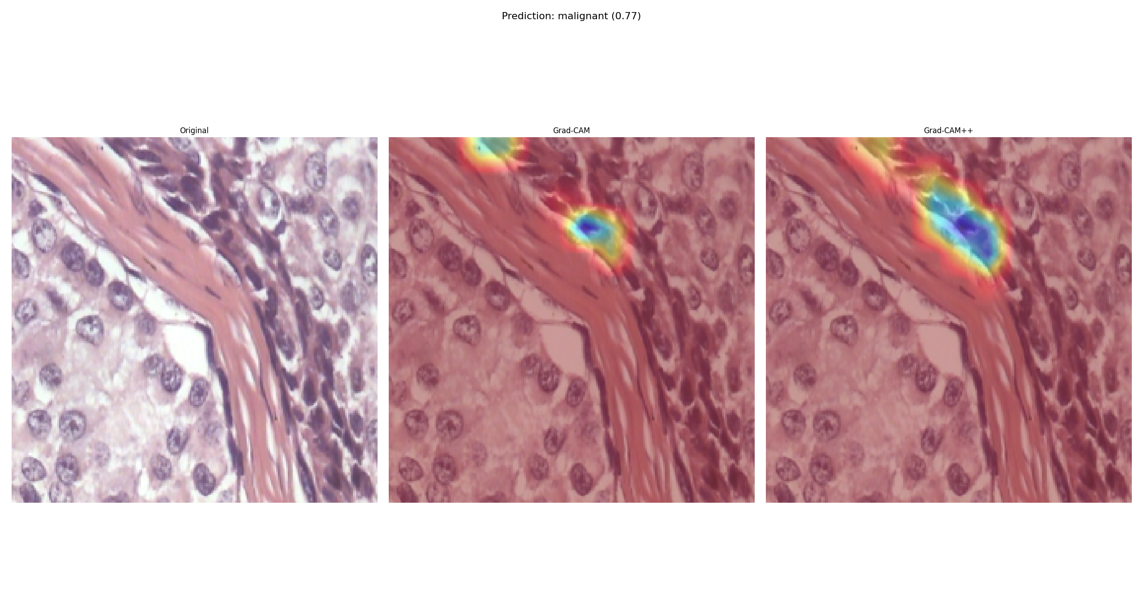
Results & Observations – Sample of Exp10 GRAD-CAM

Slide 16

Results & Observations “Continue”
Key Observations
94.49%
Experiment 10 (UNetClassifier with Composite loss and basic augmentation) achieved the highest overall accuracy (94.49%) and F1 score (0.9454), confirming the benefit of using spatial feature extraction with color information.
Experiment 11 (DenseNet121 with Focal Loss and basic augmentation) achieved strong results (F1 score 0.9316),reinforcing the advantage of handling class imbalance through specialized loss functions. Experiment 14 (EfficientConvModel with Composite loss and basic augmentation) also performed very well (F1score 0.9150), indicating that composite loss strategies combined with color features offer meaningful boosts even for lightweight architectures.
Color input (RGB)
Composite Loss
Architecture Efficiency
Significantly improved model performance across all architectures by preserving important color and textural features.
Contributed to consistent and significant gains in both recall and precision across multiple experiments (including Experiments 9, 10, 13, 14, and 15).
Compared to the original architecture (122 layers), in all 4 manually designed architectures we substantially reduced the number of layers (ranging from 16 to 29 layers) while maintaining strong classification performance.

Slide 17

Future Work
Future Work
Clinical Validation and Expert Review
Model Optimization
Real-Time Clinical Integration
Generalization to Other Domains
Notes:
Clinical Validation and Expert Review: Future research will focus on validating the model’s predictions with pathologists in real-world clinical settings. The use of Grad-CAM++ will aid in this process by providing visual justification for each classification decision, thereby helping to build trust in AI-supported diagnostics.
Model Optimization: Training time was not recorded in the current experiment logs. However, the framework is designed to allow integration of time tracking in future iterations via log timestamps or explicit time logging.
Real-Time Clinical Integration: The system may be further developed into a real-time diagnostic tool for hospitals and pathology labs, offering decision support or pre-screening capabilities.
Generalization to Other Domains: The modular nature of the framework makes it adaptable to other types of cancer, extending its impact beyond breast cancer diagnosis.

Slide 18





What I Learned
Breast Cancer Knowledge
Building Deep Learning Architecture from Scratch
Experimentation and Log Tracking
Gained a strong understanding of breast cancer pathology, particularly how histopathological features (like nuclear irregularities) can be identified and leveraged by deep learning models for diagnosis.
Learned how to design, implement, and optimize deep learning models manually, understanding each building block such as convolutions, residual connections, and efficient convolutional layers.
Mastered how to systematically conduct experiments by varying model components, track training and evaluation results with structured logging, and ensure reproducibility.
Explainable AI (XAI)
Writing a Research Paper & Crafting a Professional GitHub Report
Learned how to apply visualization techniques like Grad-CAM and Grad-CAM++ to highlight regions of histopathological images that influenced the model’s predictions, making AI decisions interpretable.
Developed skills in structuring a scientific research paper and learned how to prepare a professional GitHub repository with clean documentation and experiments logs.

